Slide 1
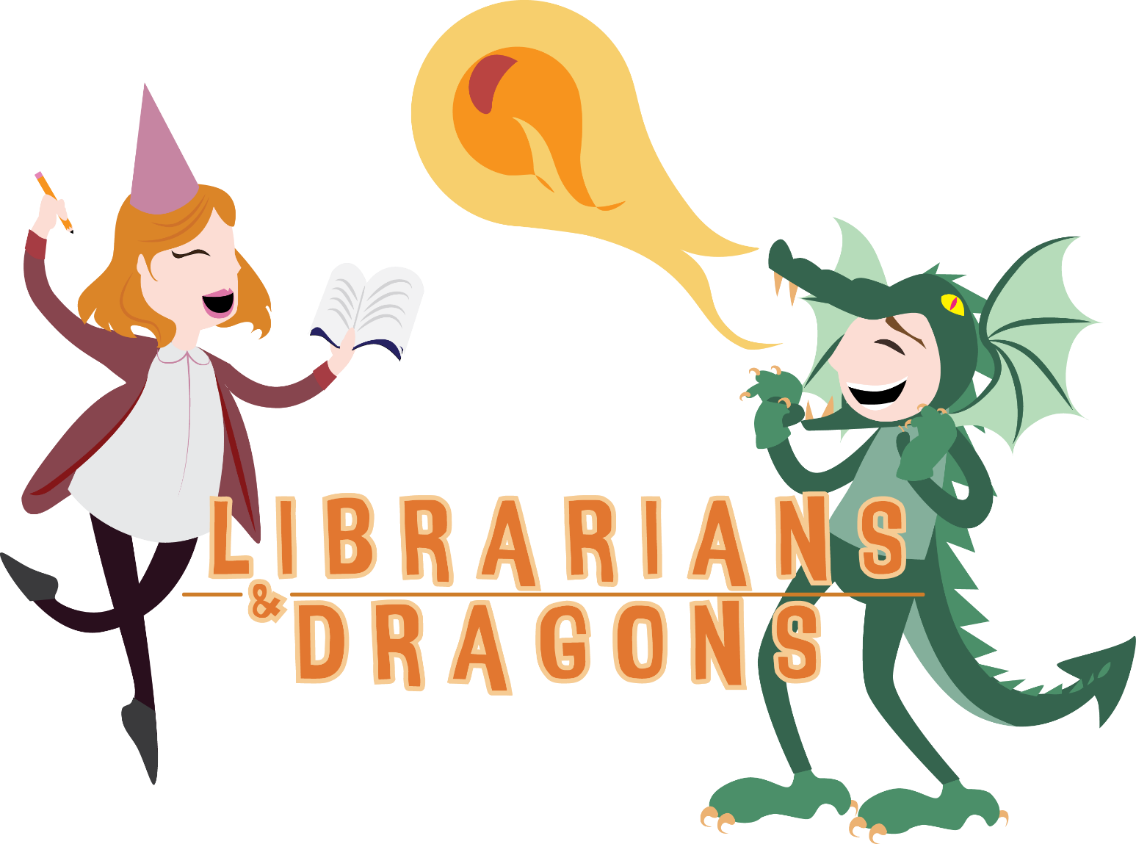
A transferable skills workshop
www.librariansanddragons.com
#librariansanddragons
Michael Hawks @mikeyh177
Madelin Medlycott @maddymedlycott
Notes:
This workshop has been designed to you identify skills you already have and how you can transfer these skills to the library world - but in a fun way! We will uses gamification to promote professional development for librarians, and to encourage a different way of thinking about the skills that we as students and new graduates can bring to the table. This workshop brings in ideas and concepts from role playing games, such as dungeons and dragons, to offer a different way of viewing our professional development. Today we are going to take you all on a quest through a library experience, using predeveloped characters, before tasking you all to develop your own character profiles, focusing on your skills and abilities (transferable skills), legendary items (qualifications) and completed trials (experience), and to begin thinking about other ‘quests’ we, as new members of the LIS community, can go on to ‘level up’ our careers.

Slide 2

Today’s adventure includes…
What are transferable skills? What the heck is gamification? What does this have to do with you?
Breaking some ice
Let the quest begin
Build your own character profile
Wrapping things up
#librariansanddragons

Slide 3
TRANSFERABLE SKILLS
What are they and what do they do?
#librariansanddragons
Notes:
According to the LIS Employment Trend Report from 2015, 37% of new graduates are employed in other industries AND their qualifications are directly relevant (ALIA, 2015). This shows us that an LIS graduate had many skills that can cross over into other work places that aren't library or information specific. These are transferable skills.
If transferable skills can work in this direction of an LIS student or graduate then why shouldn't it work in the other direction? At present only 17% of new graduates are employed in the same occupation as their studies (ALIA, 2015). We know that LIS students gain a lot of transferable skills from their studies so why such a low number in our own industry? Perhaps LIS students and new graduates are not sure how their skills can be transferred to the library and information industries? We all come from different backgrounds, have different experiences and jobs. This workshop will help LIS students and new graduates identify what skills they already have and how they can transfer these skills to those that you need to work in a library.

Slide 4
GAMIFICATION
This relates to me how?
#librariansanddragons
Notes:
But in a fun way. And what’s more fun than games? There’s lots of evidence about the benefits of games and play in education, and gamification within libraries is increasing in popularity as well. Especially in terms of engagement and motivation, game theory has been used successfully in library orientations, and for developing information literacy skills. And through Libraries and Dragons uses gamification to promote professional development for librarians, and to encourage a different way of thinking about the skills that we as new graduates can bring to the table.
This workshop is also a demonstration of what we’ve termed transferable interests. We took something that interests us personally, just in our own lives, and explored that within a library context.

Slide 5
Breaking the ice…
Pick a card, any card!
Find others with the same card as you. Easy right?
No words allowed! But you can gesture, flail, draw, make noise, anything that doesn’t use words. Also, no showing of your card to anyone.
First group to have ALL of their members and sits down wins!
#librariansanddragons

Slide 6
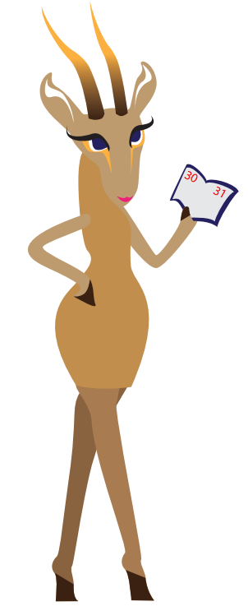
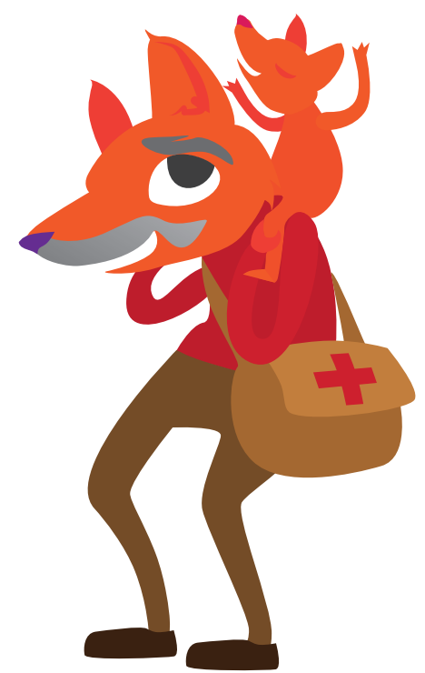
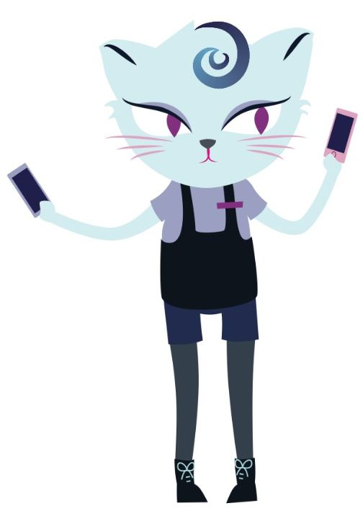
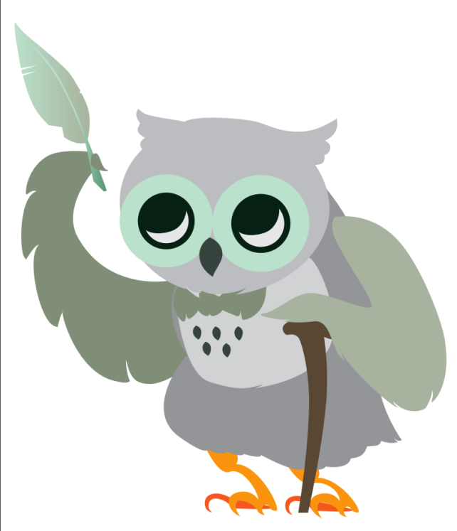
THE CHARACTERS
#librariansanddragons
Notes:
We have created a character profile template to help identify what transferable skills you might have based on your life experiences. To get ready for our quest we created character profiles for each of the characters we will be using in our quest today. Meet Take life by the horns manager aka sexy gazelle, Rad dad with all the tricks, Student cat who loves tech and Old man Hoot teacher. Have a look at your character’s profile. We have created these to give you an idea of what our character profiles look like filled in and to explain how it all works. You fill in the profiles with information about you! This includes your goals and inspirations, any allies you might have, such as a contact at a library or a mentor or even a lecturer. Next are the completed quests – your life experiences. These aren't limited to paid employment but can include anything in life where you have developed skills and knowledge such as organising a home renovation, volunteering as a sports coach or completing work placements. There are also legendary items, which are any qualifications, training, certificates you have earnt.
On the back there is a list of Library and Information skills. This list has been compiled from the ALIA general employable skills list relevant to Information Professionals working in Archives, Libraries and Records Management (https://www.alia.org.au/foundation-knowledge-skills-and-attributes-relevant-information-professionals-working-archives), as well as some additional ones from James Neal’s Skills for the 21st century librarian (https://informationonline.alia.org.au/sites/default/files/0900%20NEAL%202017%20Feb%2014%20Australia%20Presentation%20-%20James%20Neal.pptx). Using completed quests and legendary items listed you can identify what LIS skills have been developed throughout your history and move these over to the skills and abilities section. Top transferable skills are skills you rock at and other transferable ones you are good at but can improve on. It’s also important to remember what skills make you unique, the real wow ones! These go under the unique skills section. Can you see where your characters transferable skills have come from? Refer back to their completed quests and legendary items ☺
And finally, once your skills are identified you can think about what skills from the list you are missing and how you can develop these and level up!

Slide 7
THE QUEST
What? Why? How?
#librariansanddragons
Notes:
You will be taken on a quest. In order to navigate the surroundings, you will be required to overcome obstacles that stand in your way. These obstacles may contain multiple parts, you will need to resolve all issues by working as a team in order to proceed. Your objective – Navigate the quest, using your characters transferable skills.
Each character group has been given Transferable skills tokens which relate specifically back to your characters profile. We only need the your transferable skills from your profile so this is why we will be using the tokens rather then the character profiles.The BLAH coloured ones are for your top transferable skills and the BLAH coloured ones are your other transferable skills. You will need to match your transferable skills to a suitable action – eg. I will use my risk assessment skills to avoid He-who-must-not-be-named. As you use a token/skill hand the token in, you can only use each skill once!

Slide 8

THE RULES
Listen to the questmasters as they guide you through the quest.
Each character gets a turn, in order, to help solve the problem until it is solved. You will be given 30 seconds to discuss in your team what you want to for each turn.
Use your transferable skills to help solve problems that arise. There are only right answers!
Top transferable skills are super effective but you can only use these once during the whole quest.
Other transferable skills are somewhat effective but can be used multiple times
Three somewhat effective attempts from different characters = super effective.
Stay sharp, who knows what lurks around the corner…
#librariansanddragons

Slide 9
It begins with an invitation…
#librariansanddragons

Slide 10
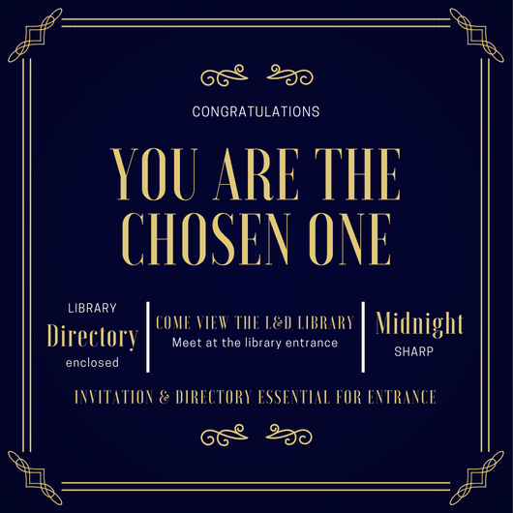
#librariansanddragons

Slide 11

#librariansanddragons
Notes:
Entrance of the library – midnight striking

Slide 12
#librariansanddragons
Notes:
Darkness of the basement – moans and rattling of chains sound effects

Slide 13


#librariansanddragons
Notes:
Demigorgon

Slide 14
#librariansanddragons
Notes:
Darkness of the basement – moans and rattling of chains sound effects

Slide 15

#librariansanddragons
Notes:
Let there be light

Slide 16
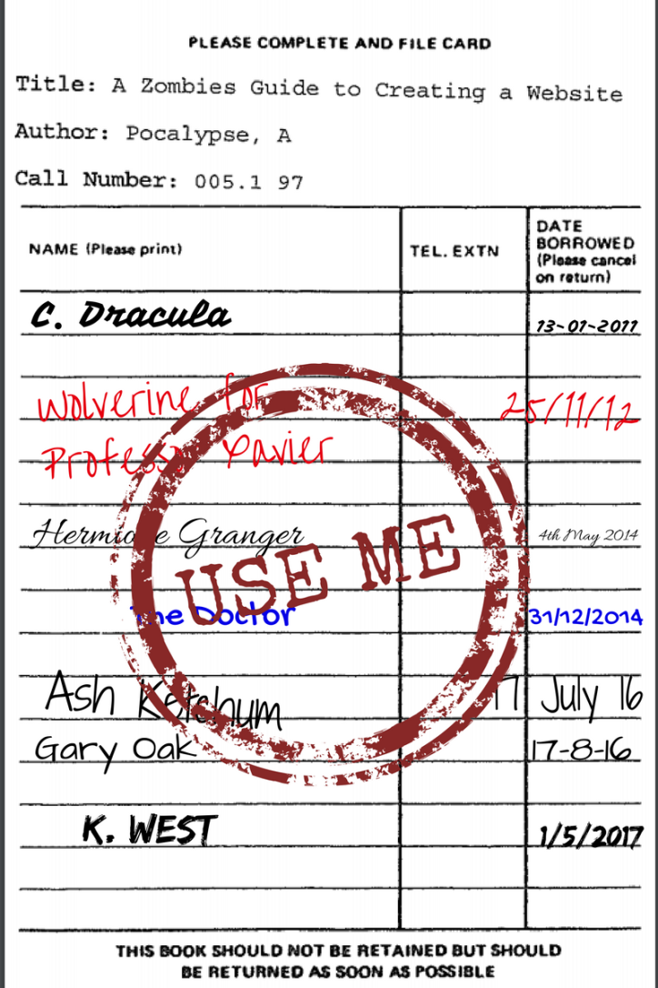
#librariansanddragons
Notes:
Catalogue cards -

Slide 17

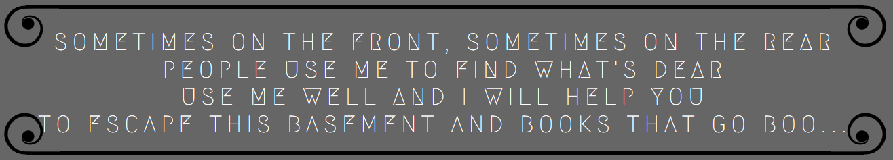
#librariansanddragons
Notes:
Riddle for lift

Slide 18

#librariansanddragons
Notes:
Scary directors

Slide 19



Annual Library Budget $100.00
Baby Rhyme Time 100th Anniversary Extravaganza!
We must support baby vampire & zombie literacy!
($60)
Purchasing the Spooktacular book collection
How else can society progress without spooky books? ($40)
Computer Skills for Dogs
Canine digital literacy is of utmost importance! ($50)
#librariansanddragons
Notes:
Shopping list

Slide 20
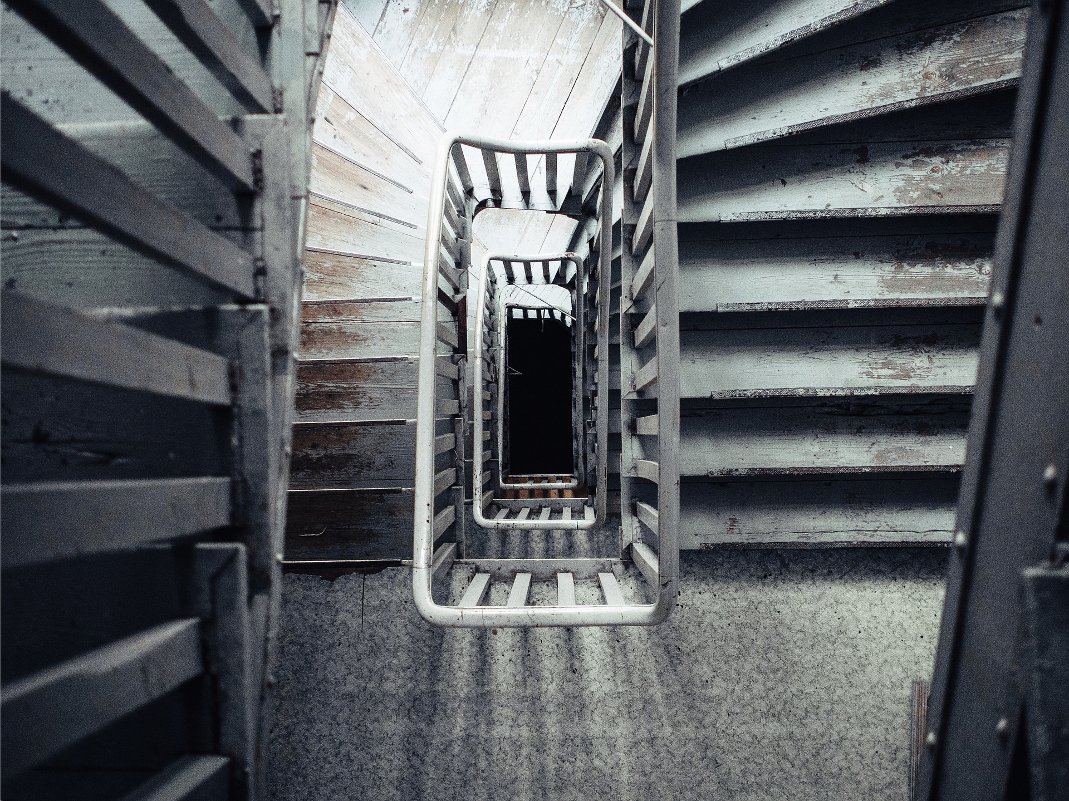
#librariansanddragons
Notes:
Happy directors

Slide 21


#librariansanddragons
Notes:
Zombie horde

Slide 22
#librariansanddragons
Notes:
Demigorgon

Slide 23
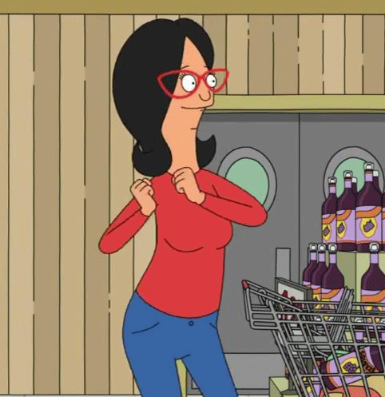
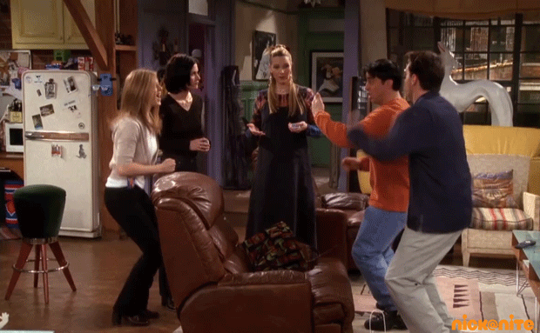

#librariansanddragons
Notes:
Success!

Slide 24
Now it is over to you!
#librariansanddragons

Slide 25
Character Profiles
https://goo.gl/MqWjbn
#librariansanddragons

Slide 26
Want more?
www.librariansanddragons.com
Visit our website for information about Librarians and Dragons including our presentation and character profile template.
#librariansanddragons

Slide 27
CREDITS
Character & logo Design:
Lewis Crooks
Music:
Happy Rock by Ben Sound http://www.bensound.com/
Zombie Horde by Mike Koenig http://soundbible.com/1833-Zombie-Horde.html
High Score by the Mushroom Kindgom http://themushroomkingdom.net/sounds/wav/sm64/sm64_high_score.wav
GIFS:
Bob’s Burger gif http://gph.is/1TzdXQy
Celebration gif http://gph.is/1hednEC
Glowing eyes gif http://gph.is/1eRyqP8
Nick at Nite gif http://gph.is/1Uq9Ppe
#librariansanddragons
Notes:
Wrap up

